Slide 1














Advanced End User
Version 6.3
© ThoughtSpot Inc 2019

Slide 2
Learning objectives
Save and share Answers and Pinboards
Auto Analyze with SpotIQ
Use Answer Explorer
Master complex searches
Use Conditional Formatting
Search with keywords
Create Formulas
Upload your own data
Notes:
This session is a continuation of the End User Essentials session, and covers more advanced end user feature functionality. This is a hands-on session which will require internet access with a browser, and a spreadsheet editor, such as Excel.

Slide 3
Answers

Slide 4
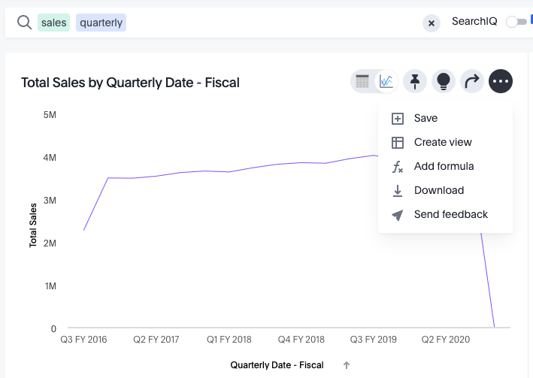
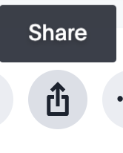
Saving your Answer
Save an Answer to work on it more later, or save another user’s Answer as a copy so you can edit it.
Notes:
An Answer is the result of a single search. You can save an Answer you want to work more on later, or you can save it to keep for your personal use. You can also share an Answer with other users. Save an Answer by selecting Save from the dropdown list of the ellipsis icon.
You may also save a search as a View, so it can later be retrieved as a Data Source.

Slide 5
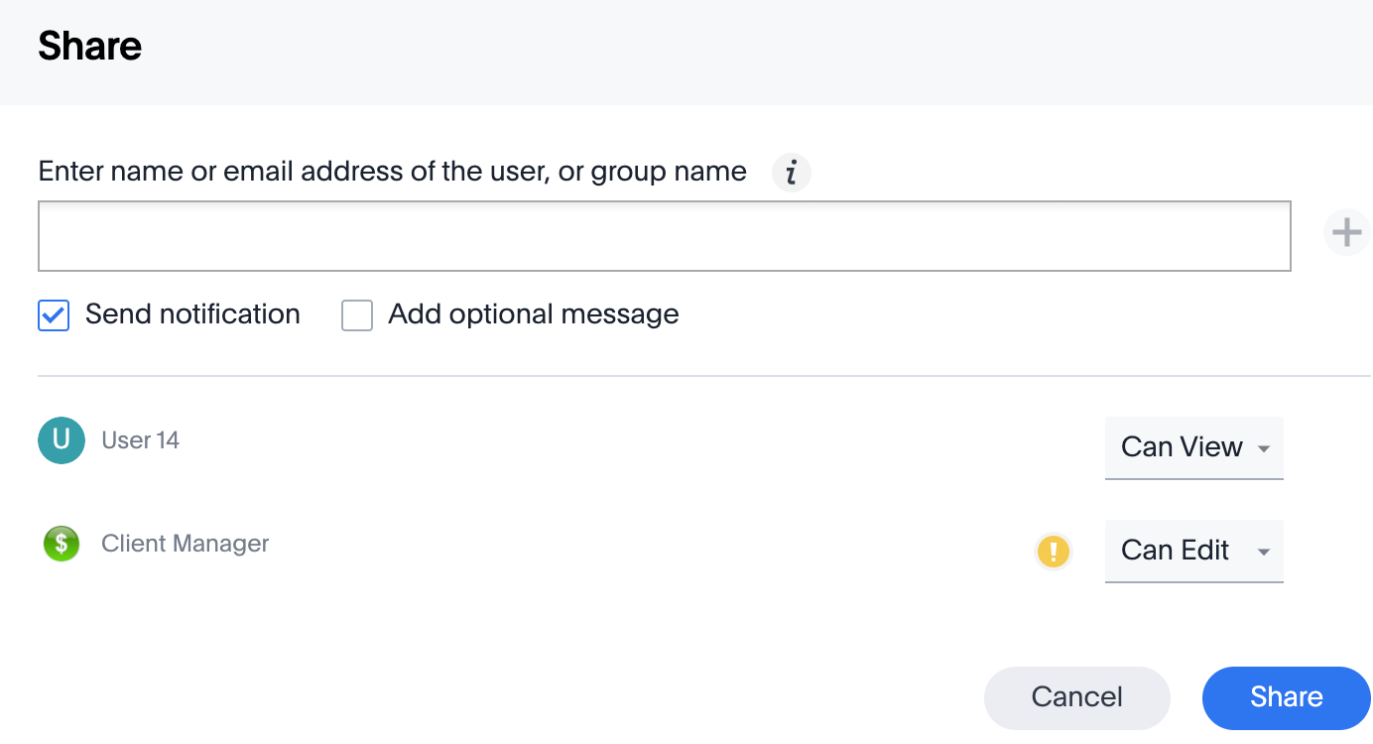
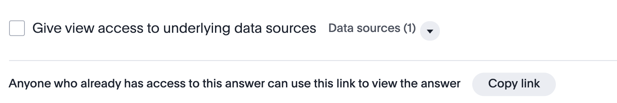
Sharing your Answer
Share Answers or Pinboards with others, with either View or Edit access.
Allow others to either View or Edit.
Notes:
When sharing an object, you can use the checkbox to give the user(s) or group(s) access to the underlying data source.

Slide 6
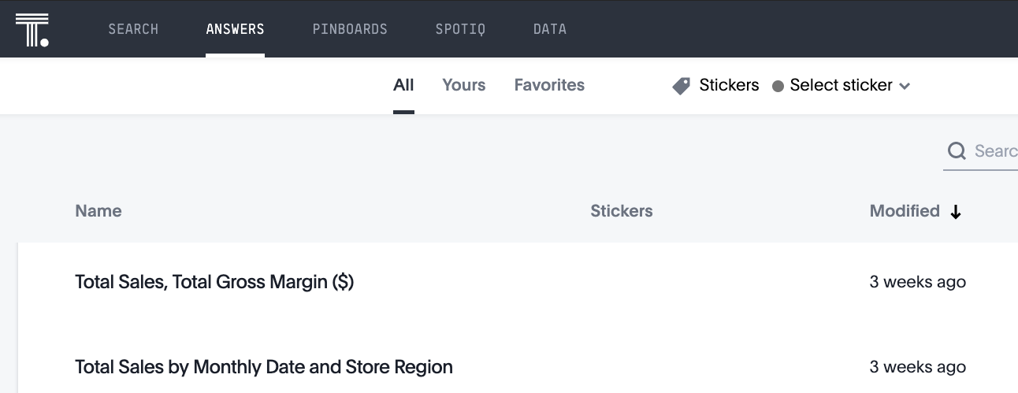
Retrieving your answer
You can find the Answers that have been shared with you, and Answers that you have saved, in the Answers tab.
Notes:
The Answers tab is where you can view and edit your saved search results. You can filter Answers by All, Yours, and Favorites. You can also use stickers to organize Answers.

Slide 7
SpotIQ

Slide 8
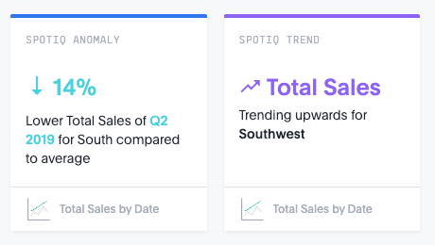
SpotIQ Insights
SpotIQ’s automatically generated insights can answer interesting answers in your data that you may not have found on your own.
Notes:
SpotIQ helps you find insights into your data. You may find SpotIQ insights located just below answers. These insights could include anomalies, trends, or correlations. They may even answer questions that you did not think to ask! SpotIQ also learns from your responses to your insights. Meaning, how you interact with SpotIQ results helps to build better results.

Slide 9
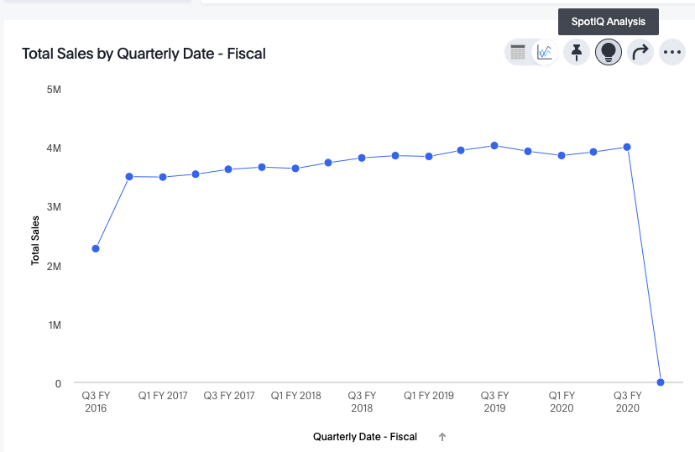
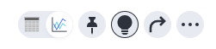
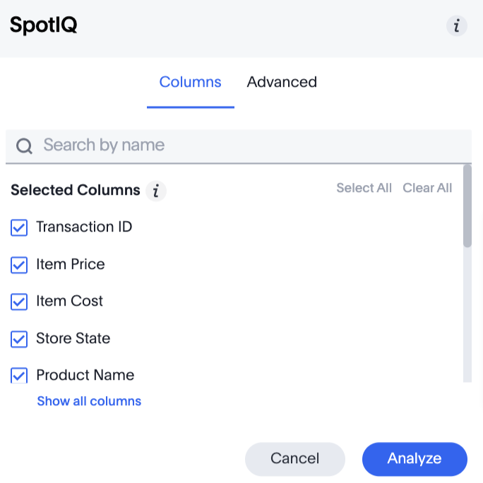
SpotIQ Insights
Click the SpotIQ icon above a chart to launch automatic analysis for a search.
Customize analysis by explicitly indicating which columns to include or exclude.
Notes:
The Advanced tab allows you to select additional parameters for your SpotIQ analysis.

Slide 10
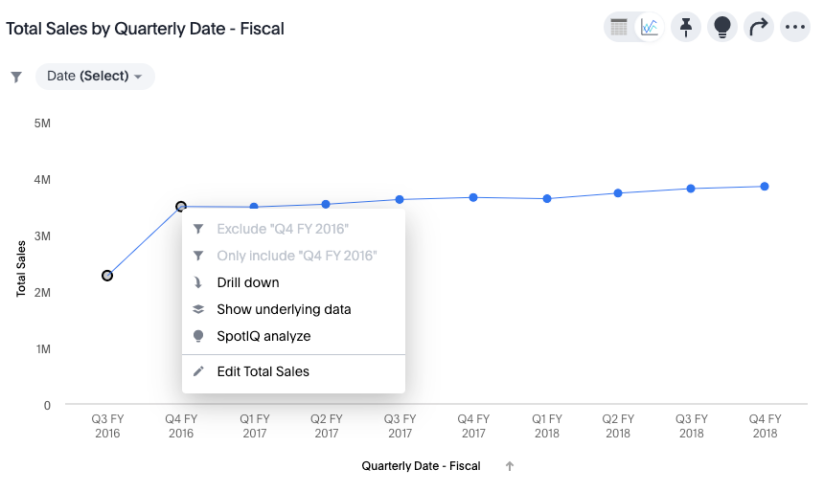
Comparative Analysis with SpotIQ
You can even compare two data points by running SpotIQ on only those data points that are selected. Highlight the data points of interest, then right click to select SpotIQ.

Slide 11
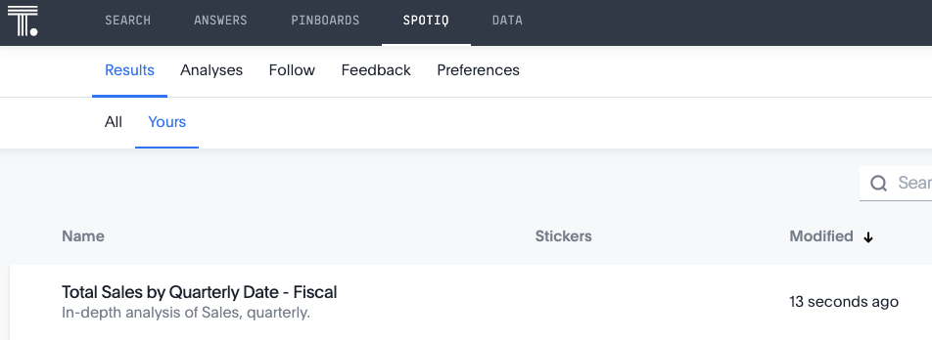
Where to find SpotIQ insights
You can find results of your SpotIQ analysis in the SpotIQ page of the top menu bar.
Notes:
Once SpotIQ analysis is initiated, the results are saved in the SpotIQ page. Click SpotIQ from the top menu bar to view the results of your analysis and analysis that is in progress. Notice that ThoughtSpot saves the results of SpotIQ analysis for 24 hours, unless you explicitly Save it.

Slide 12
What am I looking at?

Slide 13
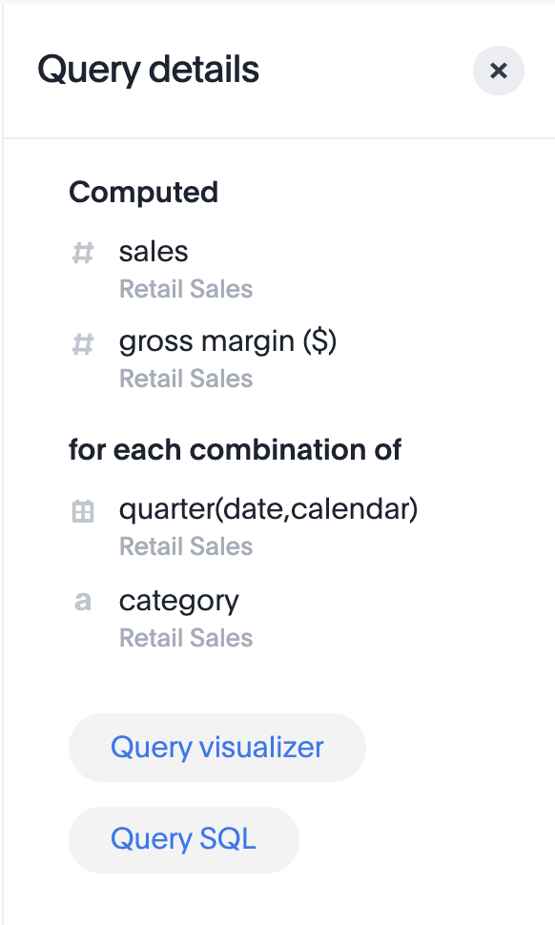
What am I looking at?
Click Query Details to see how ThoughtSpot displays an Answer.
Notes:
To view details about a search, select the Query details icon located to the right of an chart, and open the Query details panel. This panel shows the measures that ThoughtSpot computed, for each combination of attributes. Choose Query visualizer to see search filters and how the tables were linked and used.

Slide 14
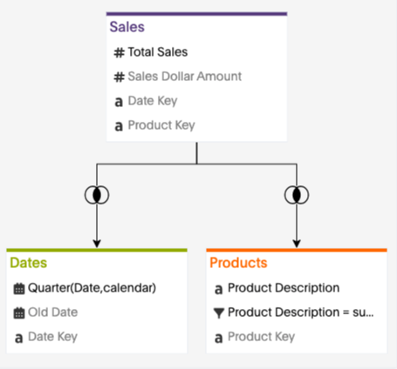
Query Visualizer
The Query Visualizer displays search filters and how tables are linked for a search.
Notes:
The Query visualizer displays the search filters and how the tables were linked and used. You can also see the join types, though you are not able to edit them here.

Slide 15
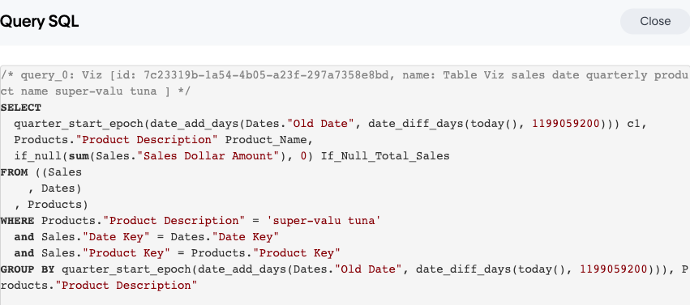
Query SQL
View the SQL behind a search to validate your query.
Notes:
For validation

Slide 16
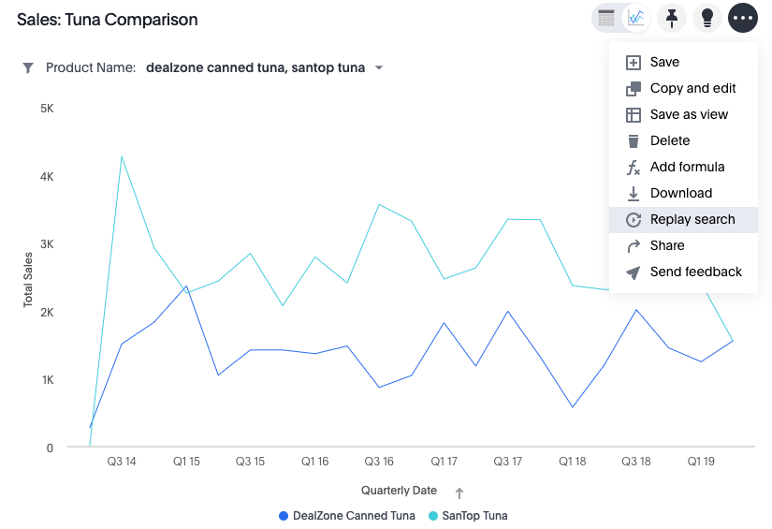
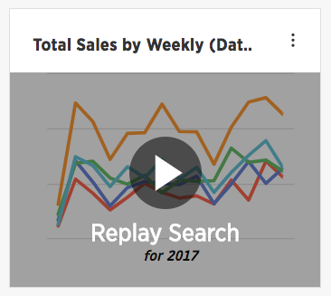
Replay Search
You can instantly generate a step-by-step replay showing the creation of a table or chart.
Notes:
The replay feature shows the step-by-step process of how to create the chart or table you are viewing. Use it to teach yourself, or use it as a training tool to teach other users.

Slide 17
Make a Copy of an Answer
Make a copy of an Answer to save without overwriting, or to edit an Answer saved by another user.
Notes:
You can edit a copy of an Answer if you would like to make edits without changing the original answer. When saving, you can type in a different name for your copy.

Slide 18
Pinboards
Notes:
Pinboards are the ThoughtSpot term for a dashboard. Use Pinboards to group and manage related search results. Pinboards are a collection of your related charts, tables, and headlines.

Slide 19
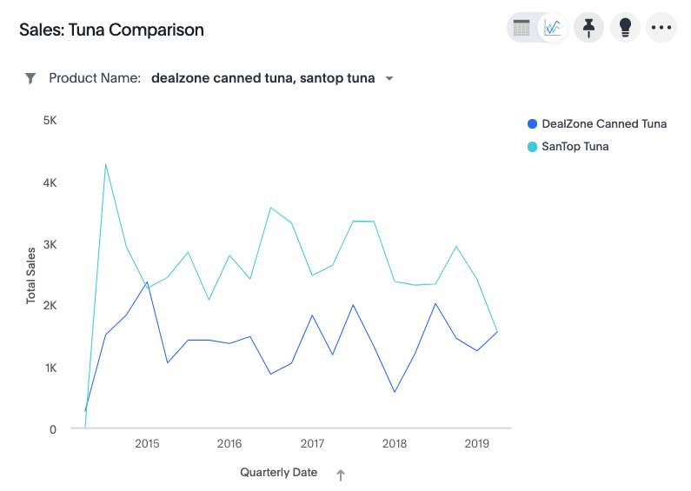
Pin a chart to a Pinboard
While viewing an answer, click the Pin icon at the top right of the answer
Select an existing Pinboard, or create a new Pinboard.
Notes:
Add a visualization or table to a Pinboard by clicking the Pin icon at the top right of the Answer. You can either add it to an existing Pinboard, or create a new one.

Slide 20
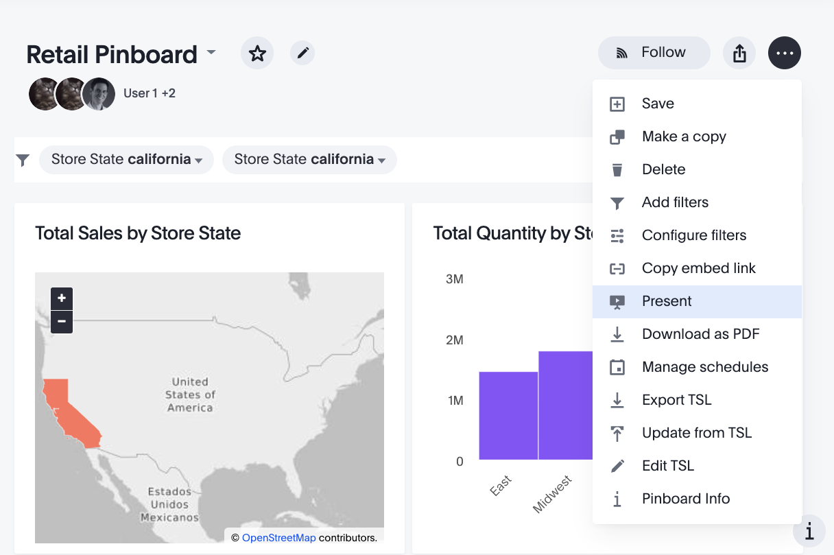
Slideshow from a Pinboard
Turn your Pinboard into a slideshow and answer audience questions during a presentation.
1
2
Notes:
You can present your Pinboard as a slideshow, and turn your Pinboard into an interactive presentation. You can easily explore and answer questions from the audience during the presentation. Each visualization is displayed as a slide, and you can Drill Down, run SpotIQ, Show Underlying Data, and Filter within the presentation. Use your arrow keys of the keyboard to navigate the presentation.

Slide 21
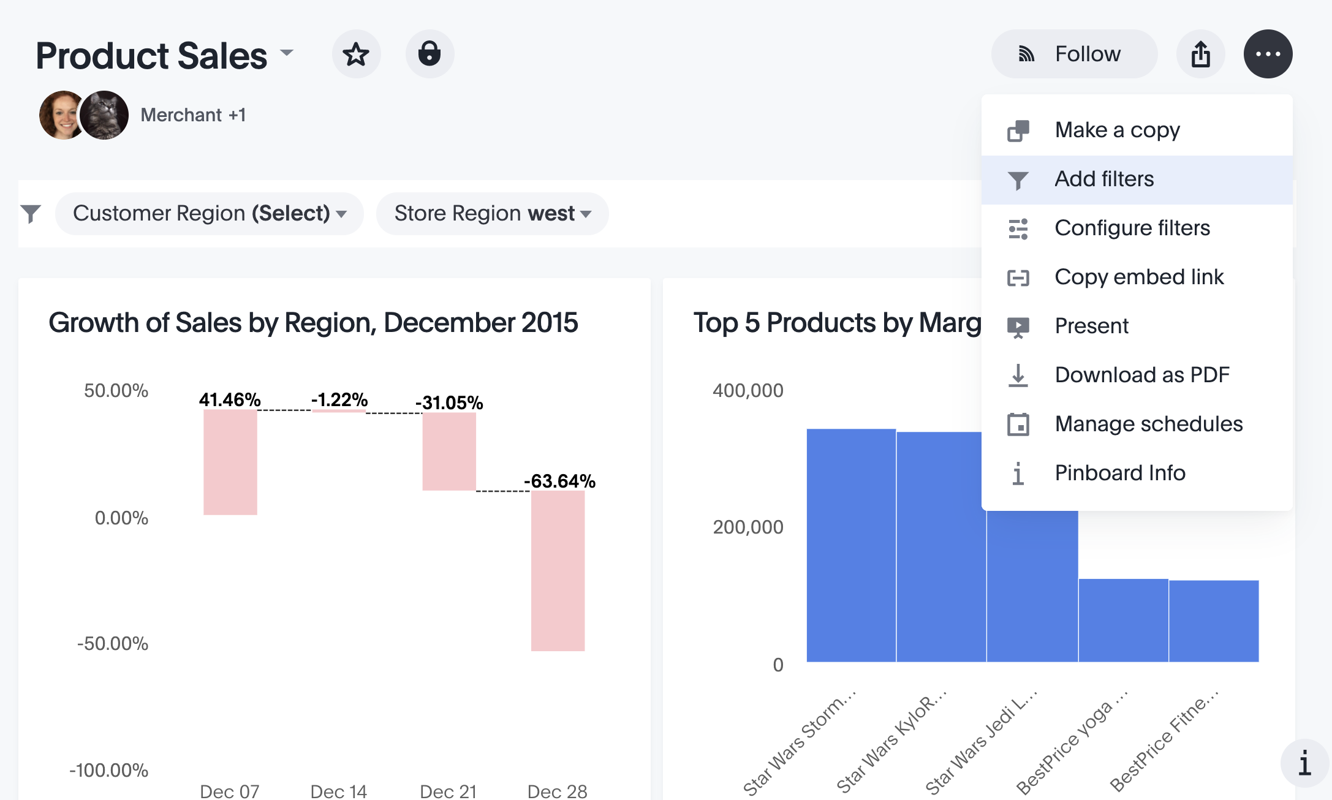
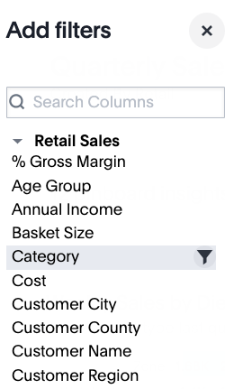
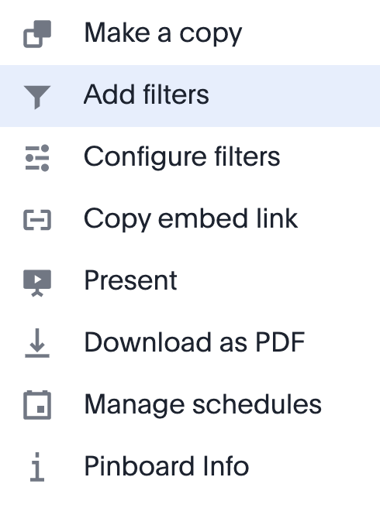
Pinboard Filters
Pinboard filters work like normal filters, and apply to all or some objects on the Pinboard.
You can view and change the filters using the filter list.
Notes:
Filters, including bulk filters and exclude filters, can be applied to Pinboards just as with tables and charts. These kinds of filters apply to an entire pinboard, making it easy to see only the data that you are interested in across the tables and charts within a pinboard. Pinboard filters can be very useful when you want to apply the same filters to more than one related visualization. You can narrow the focus of your pinboard for specific purposes or audiences. Selective Pinboard filtering allows you to filter specific visualizations on the Pinboard, and not all of them.
When you apply a filter, the filter is not automatically saved on your Pinboard to encourage ad hoc filtering. Note that if you filter a Pinboard on a dimension that was already filtered on the Answer level, the Pinboard filter overrides the Answer filter.

Slide 22


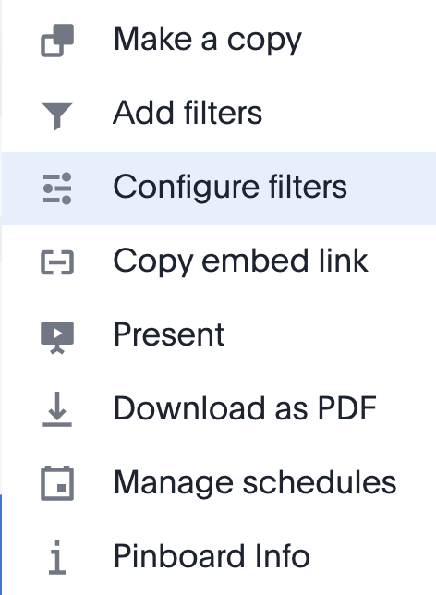
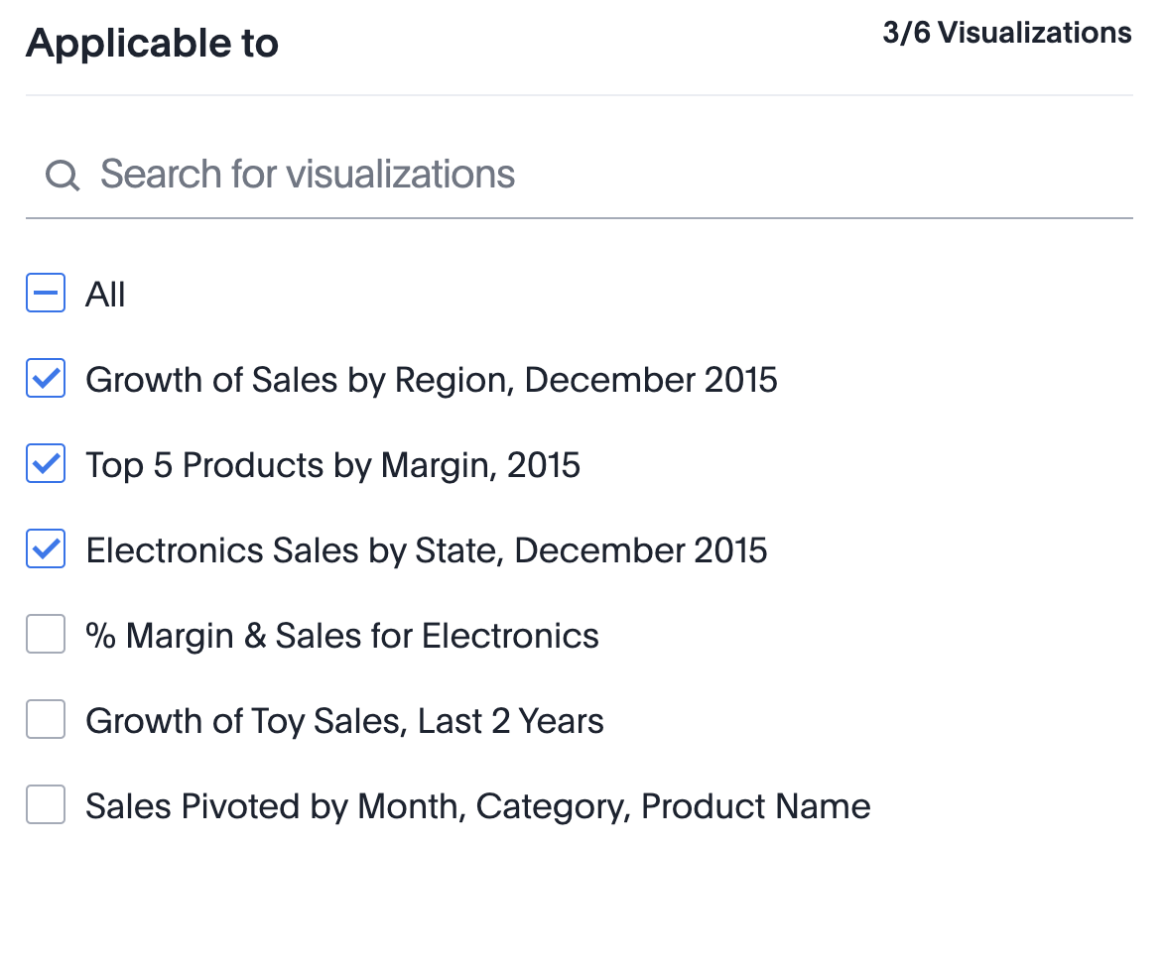

Selective Pinboard Filters
Apply a Pinboard filter selectively, to specific visualizations of the Pinboard.
Navigate to the Configure filters modal, then scroll down to select which visualizations the filter should apply to.
Notes:
You can apply Pinboard filters to specific visualizations from the Configure filters modal. Create a new Pinboard, or open an existing Pinboard, with a filter applied. Then, click the more options menu (ellipses icon) and select Configure filters. Then, the side menu will appear, which contains every primary filter column for the Pinboard. Scroll down to select which visualizations the filter should apply to, and select Done.

Slide 23
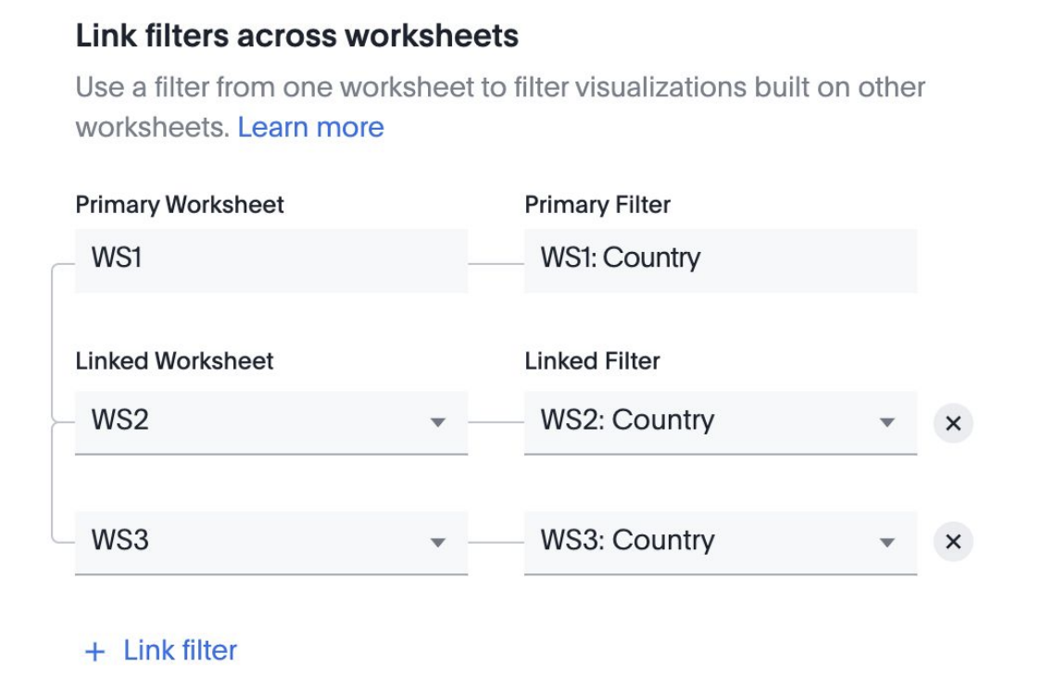
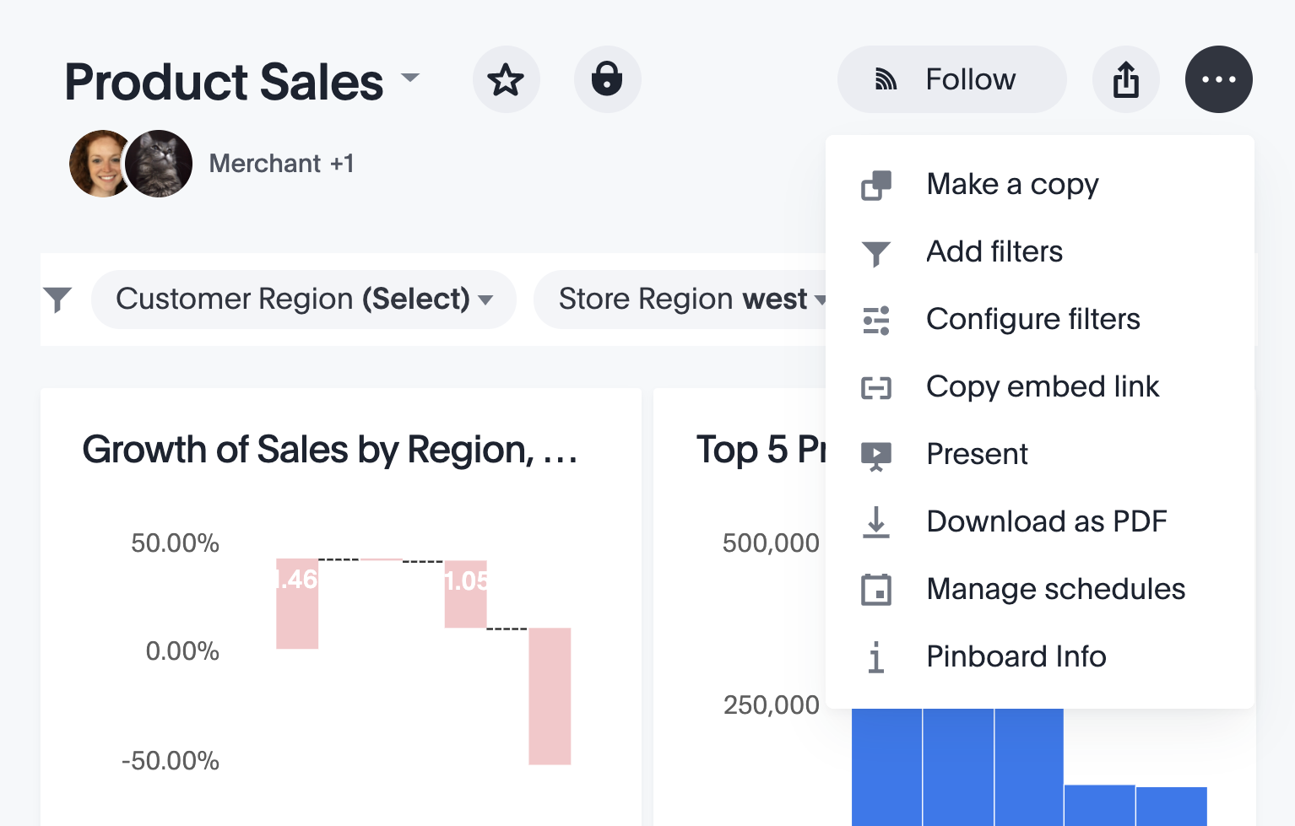
Linked Pinboard Filters
You can link columns from multiple Worksheets, to create one Pinboard filter for visualizations that come from different Worksheets.
Link similar columns across worksheets to create unified filters.
Navigate to Configure filters, then link filters across worksheets.
Notes:
You can link the Worksheet columns at the Pinboard level without actually filtering the Pinboard, to give your users the ability to choose their own filters for the Pinboard. Also, ThoughtSpot expects the values in the Worksheet columns you link to have the same names. You can only use the values of the Primary Filter to filter the Pinboard visualizations, so if the value names are different in the Linked Filter, you are unable to filter visualizations based on the Linked Worksheet.

Slide 24
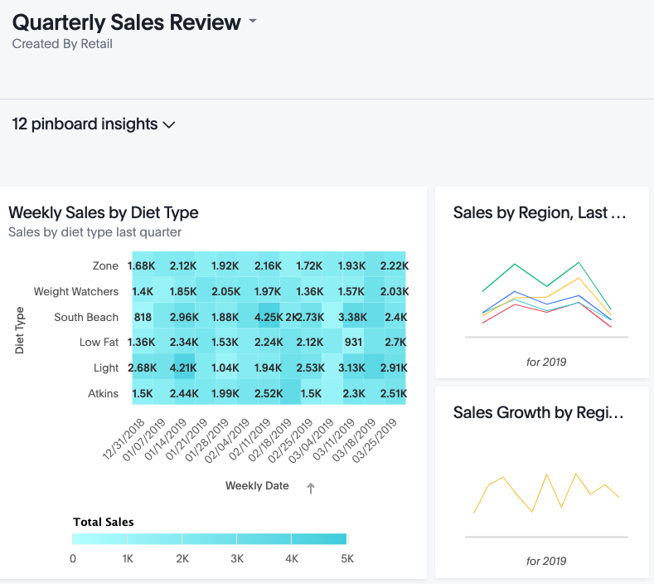
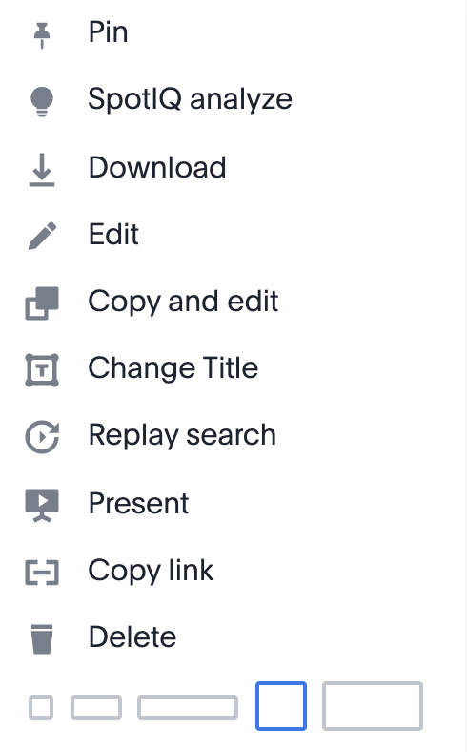
Pinboard Actions
Pinboards support exploring and organizing data without having to leave the pinboard view.
Actions include:
Drilling down
Changing date bucketing granularity
Adding filters
Sorting
Resetting
Notes:
Pinboards are interactive, allowing you to perform actions on multiple visualizations at once. You can reshape the visualizations on your Pinboard, and rearrange them by dragging and dropping.

Slide 25
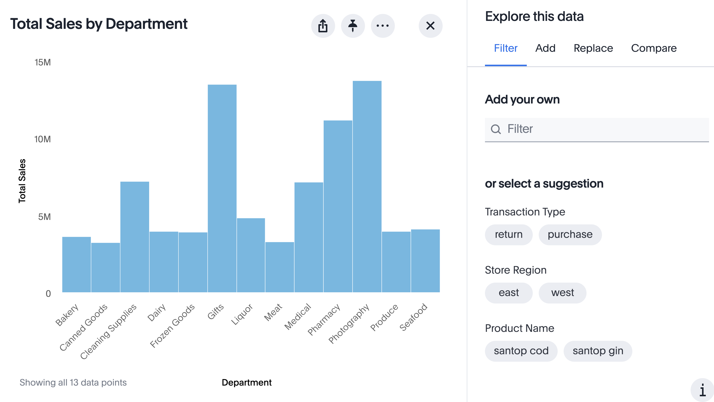

Answer Explorer
Quickly add filters, make comparisons, breakdown data, and add measures through AI-guided exploration of Pinboards
Notes:
Answer Explorer, ThoughtSpot’s AI-guided exploration of Answers and headline metrics within Pinboards, provides you with valuable suggestions on how to explore and understand your data. Quickly add a filter, or use the Compare tab to easily perform a “versus” analysis. Use the Add and Replace tabs to include more columns in the visualization, or swap existing columns. You can access Answer Explorer from any Answer or headline metric in a Pinboard. Answer Explorer’s AI updates its suggestions every time you add something new to your visualization. Suggestions are based on popularity and personalization.
You can Drill down from within Answer Explorer. When you Drill down in Answer Explorer, you have the option of going back one step at a time, using the Back icon.

Slide 26
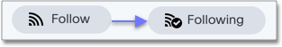
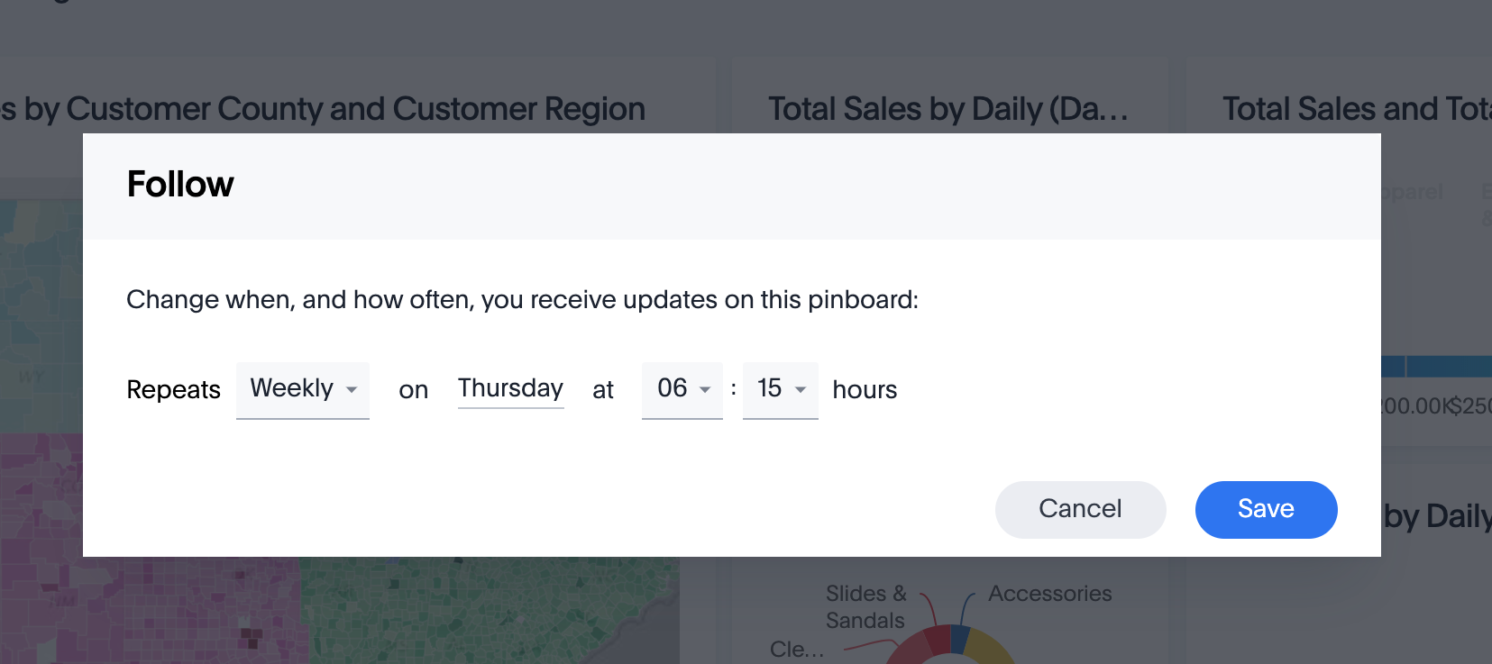
Follow Pinboards
You can follow Pinboards to get regular updates in your inbox. Click the Follow icon on the top right of your Pinboard.
Notes:
You can follow Pinboards and have them sent to your inbox on a regular basis.

Slide 27
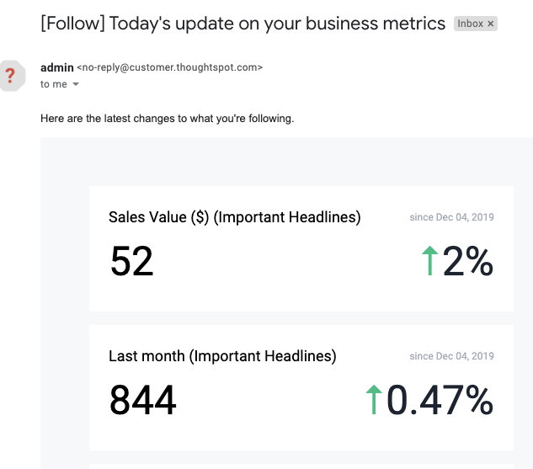
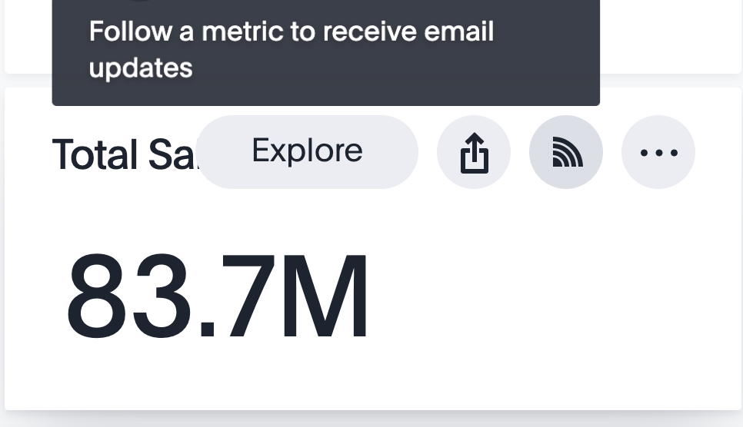

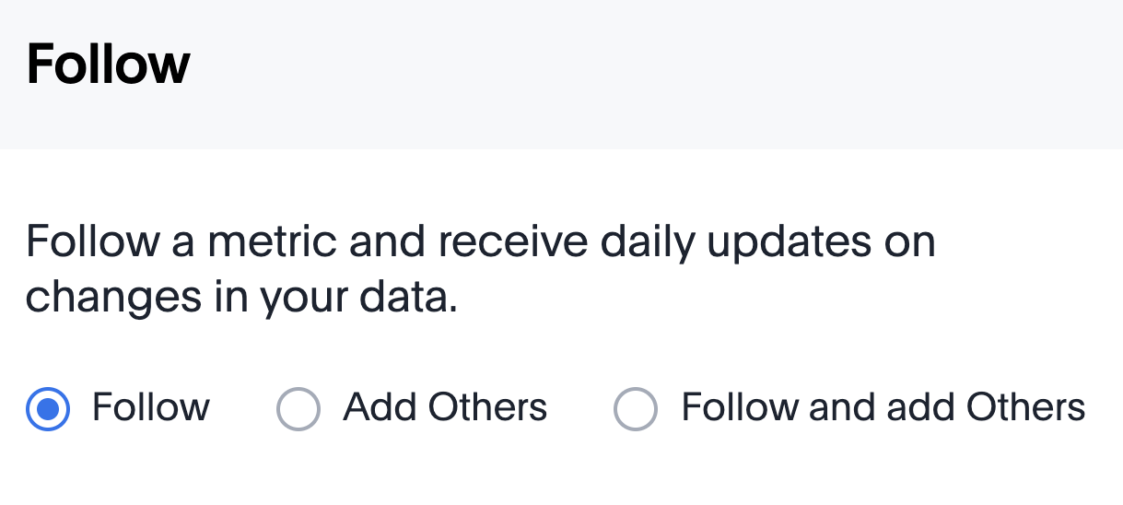
Monitor headlines
Follow headline metrics of your favorite Pinboards, and get daily updates in your email mailbox, on your ThoughtSpot home page, or in the SpotIQ page.
Notes:
You can monitor any metric, or KPI, that has been pinned to a Pinboard. You will receive daily email updates reporting how that metric has increased or decreased over time. A user can follow up to 50 metrics, and he/she will receive one email daily with their metric updates. Users can even add others to follow a metric. Currently, the frequency of the daily email cannot be configured.

Slide 28
Sharing

Slide 29
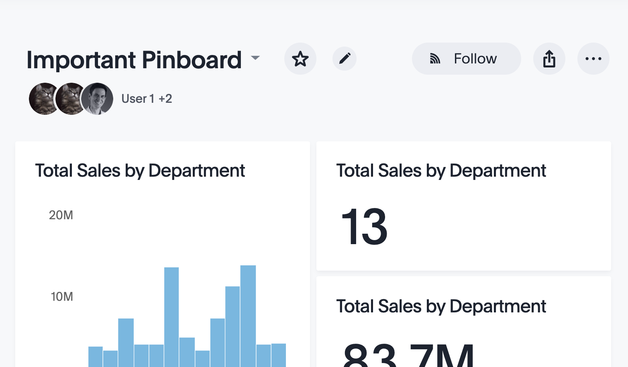
Share Your Pinboard
Share Pinboards easily with other users, groups, or email addresses. Choose whether to share with Edit or View only access.
Notes:
Whenever a user views a Pinboard, he/she will see the most recent data (based on the frequency of the data refresh).

Slide 30
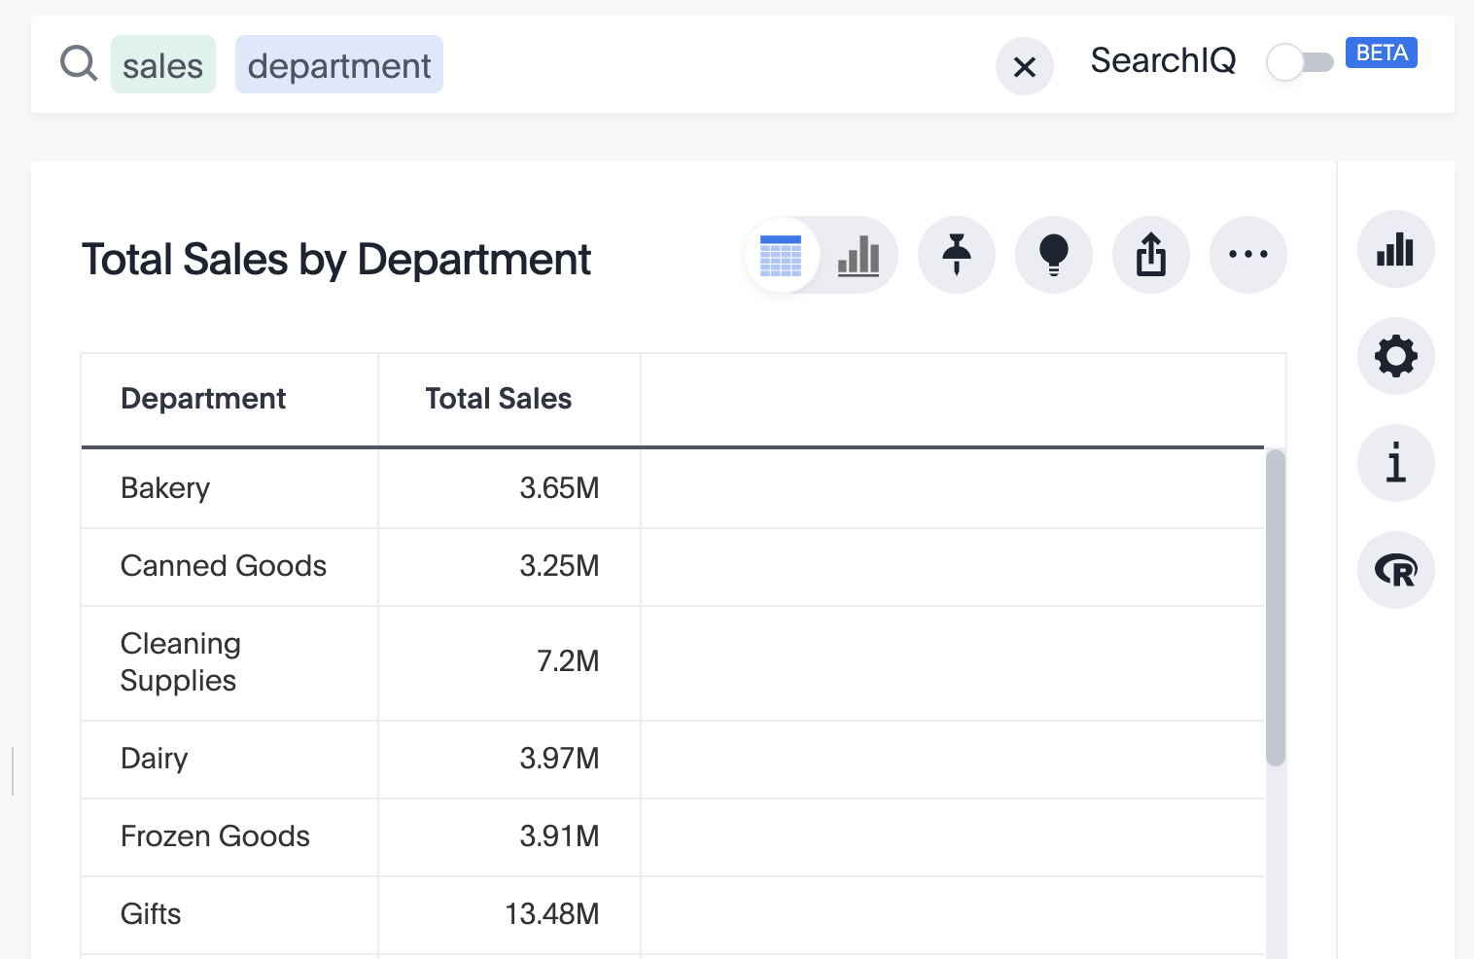
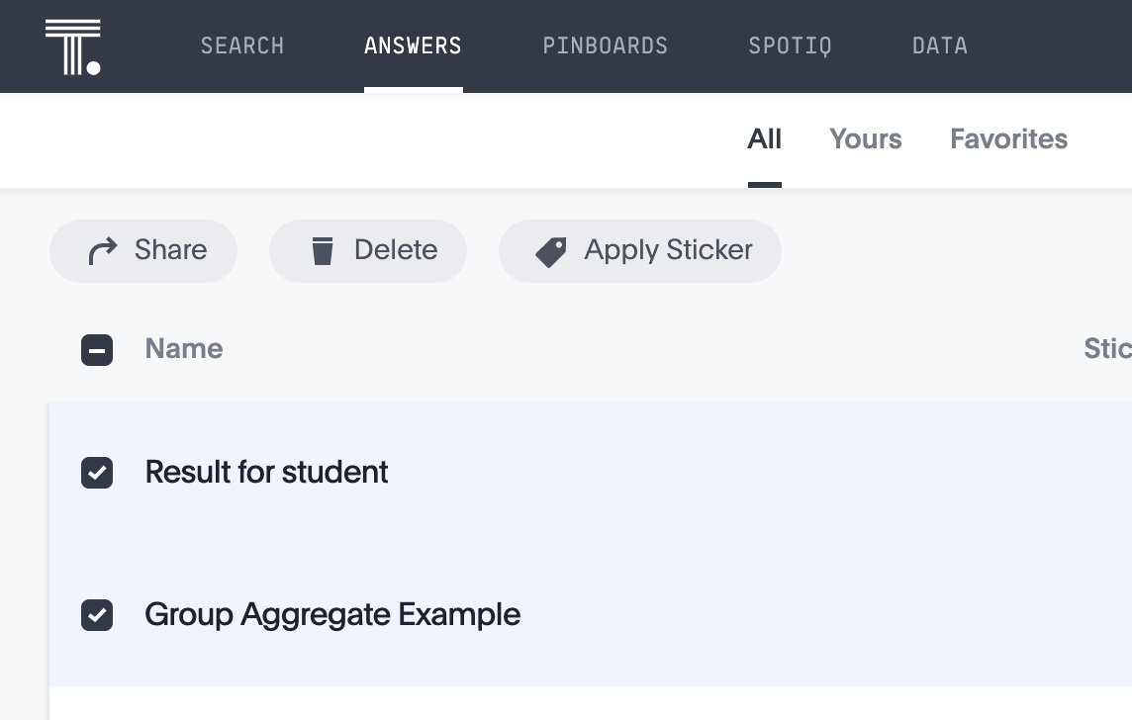

Share Your Answer
You can share Answers the same way!

Slide 31
Sharing Settings
Share objects with others, with either View or Edit access.
Allow others to either View or Edit.
Notes:
When sharing an object, you can use the checkbox to give the user(s) or group(s) access to the underlying data source.

Slide 32
Data Sources
Notes:
When you navigate to the Data tab, you’ll see all data sources available for you to search on. Not all of them may be searchable, if you do not have access to underlying data in all tables.

Slide 33
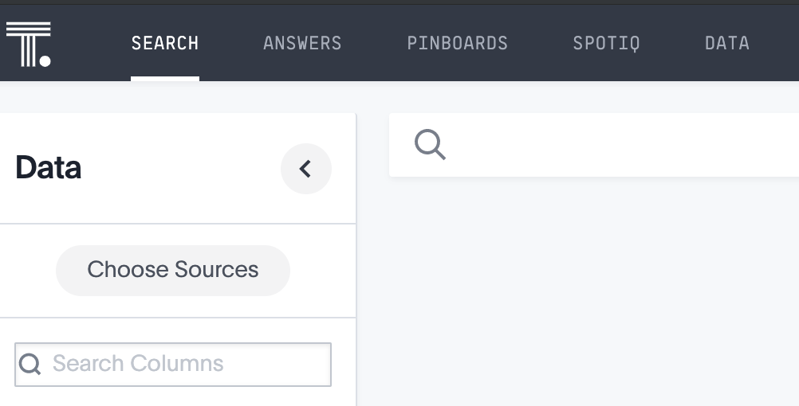
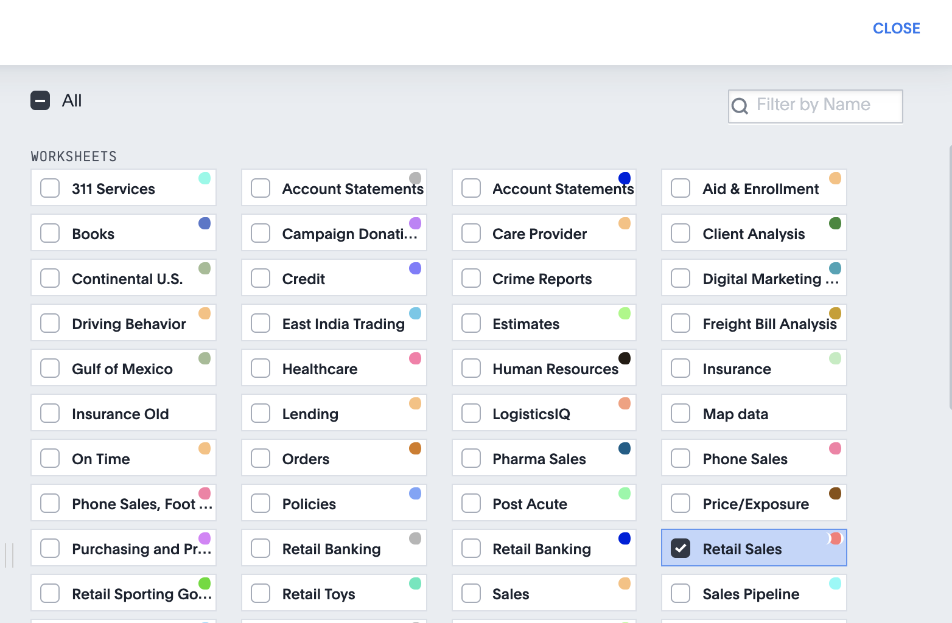
Data
Choose Data for a list of all data sources (not all may be searchable)
Notes:
If you suddenly cannot see your data, it is likely because you have a sticker selected that is not applied to anything. Deselect the sticker by clicking it, and your data will appear. Searches happen within the context of selected data sources.

Slide 34
Select a Data Source
Types of Data Sources
Name | Definition | Created By | Used By
Table | Raw tables loaded by an Administrator | Administrators | Administrators
Worksheet | Collection of related tables, optimized for searching | Anyone | Anyone it’s shared with
User Imported | Table uploaded by a user through the Web browser | Anyone | Anyone it’s shared with
View | A prior search saved as a data source | Anyone | Anyone it’s shared with
Notes:
This table shows the main types of Data Sources a user can search on. Worksheets are flat tables created by joining columns from a set of one or more tables or imported datasets, and they are optimized for searching. Views allow you to save a prior search as a data source, and search on top of another search. Typically, end users work with Worksheets and any data they have uploaded.

Slide 35
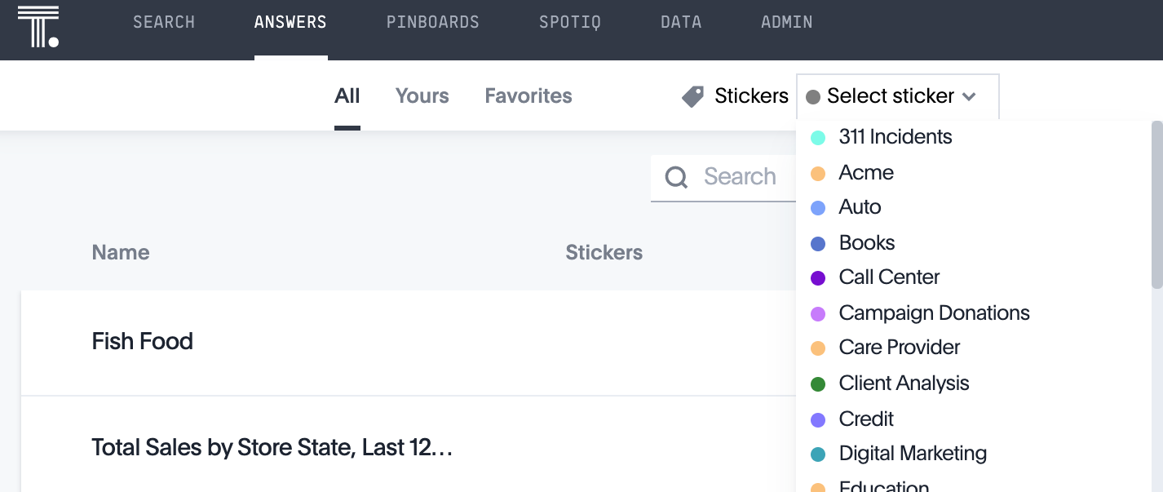
Stickers
Stickers help you organize and find things. Administrators make Stickers, but anyone can use them.
Notes:
Stickers enable you to create categories for classification of objects, including Pinboards, Answers, Data Sources, and Worksheets. You can create stickers to make it easier for people to find Data Sources and Pinboards. Everyone can see stickers and use them to tag objects. You can also use stickers to filter a list of objects. Stickers are often used to designate subject areas, such as sales, HR, and finance. Only administrators can create a sticker, but anyone can apply or filter with a sticker.

Slide 36
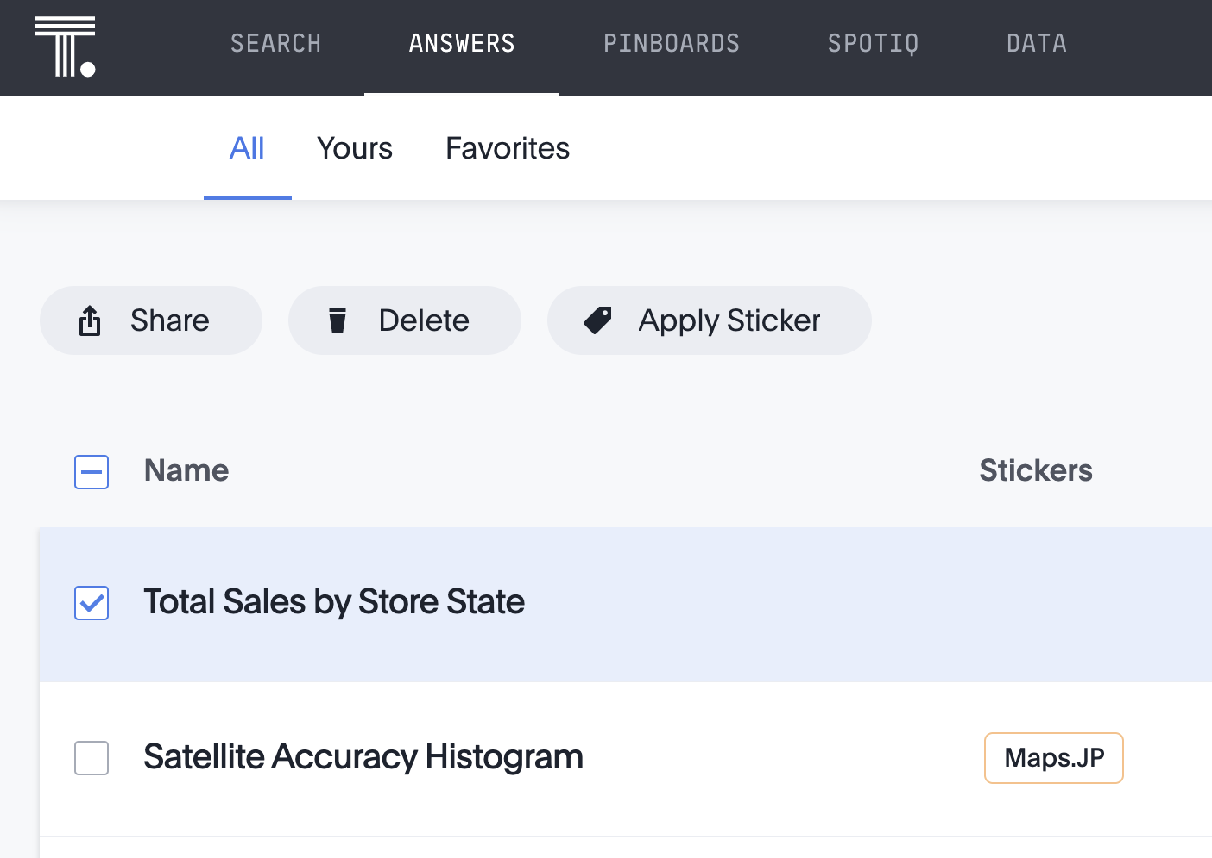
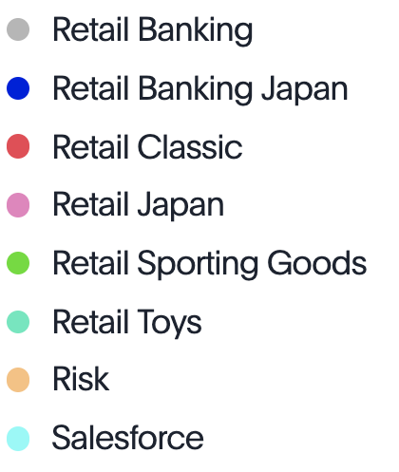
Apply Stickers
To apply a Sticker, Select an Answer, Pinboard, or Data Source, and select Apply Sticker. You can apply multiple stickers to one object.
Notes:
Anyone who has edit access to an object can apply a sticker to it.

Slide 37
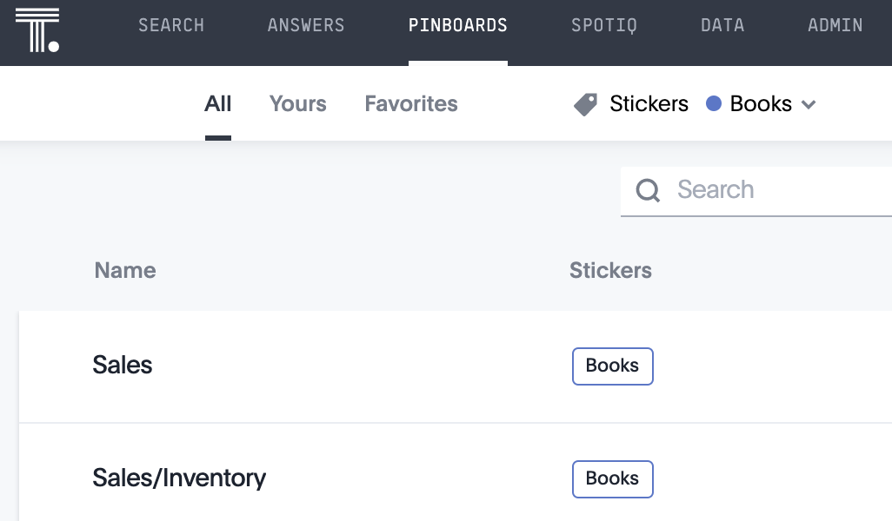
Use Stickers
Use stickers to easily find Answers, Pinboards, and Data Sources.

Slide 38
Auto-Analyze with SpotIQ

Slide 39
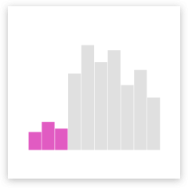
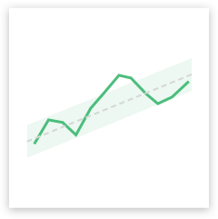
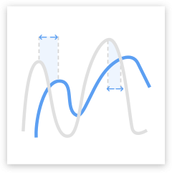

SpotIQ
Run SpotIQ to find insights when you don’t know what to ask, want to get a quick overview of new data, or want to learn more.
Notes:
SpotIQ is a ThoughtSpot feature that helps you find insights into your data. Insights are trends, correlations, explanations of increases, explanations of decreases, and outliers (values unique from what is typical in your data).

Slide 40
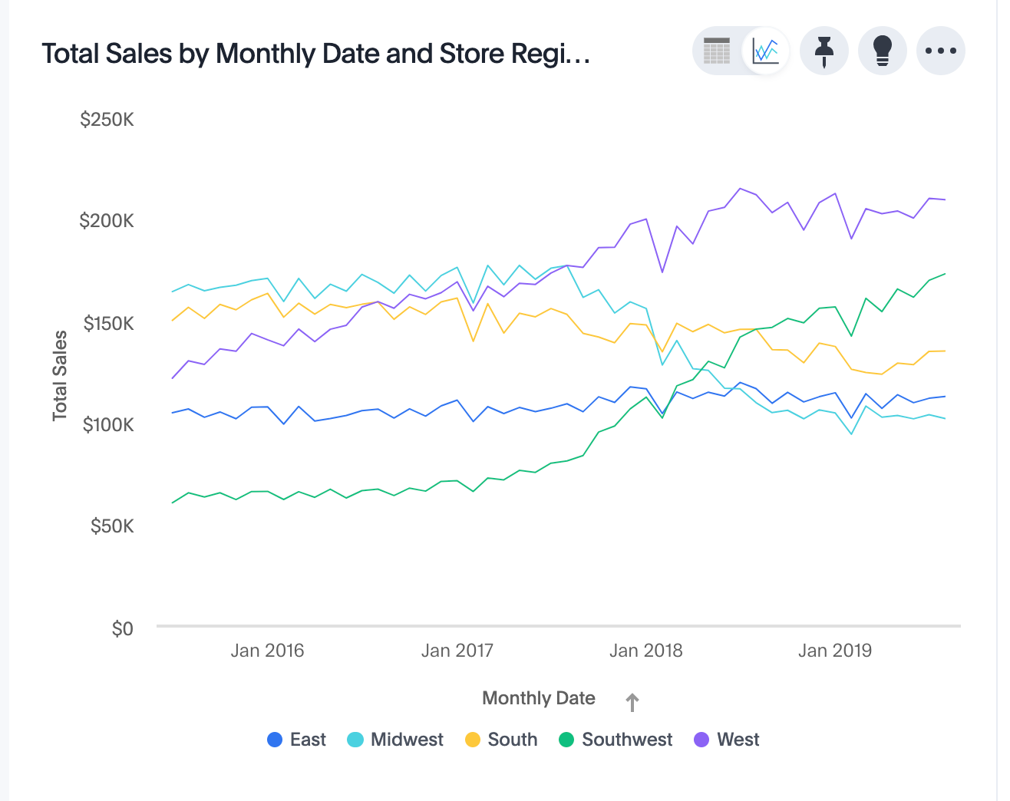
SpotIQ on a Chart
Click the lightbulb icon to better understand what is going on with your chart

Slide 41
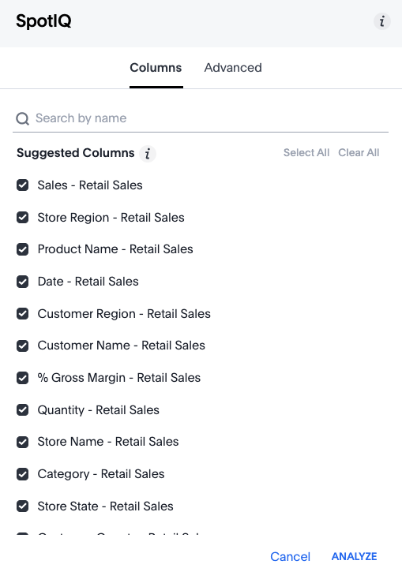
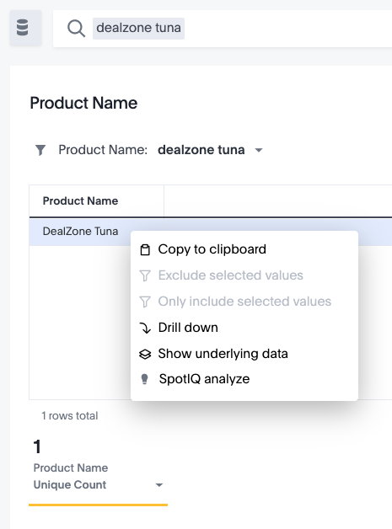
SpotIQ on a data point
“What’s going on with this product?”
Notes:
You can run SpotIQ (auto-analyze) on a single point, by right clicking one or selected data points. Select which columns to include in the SpotIQ analysis. If you are unsure, keep all selected suggested columns. In the Advanced tab, you can further fine tune statistical analysis preferences.

Slide 42
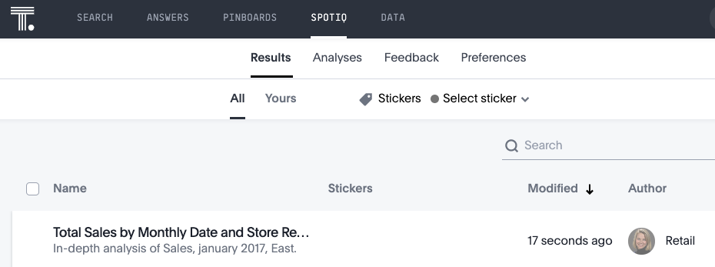

SpotIQ
You will find SpotIQ analysis in the SpotIQ tab of the top menu bar.
Click on its name to view the results.

Slide 43
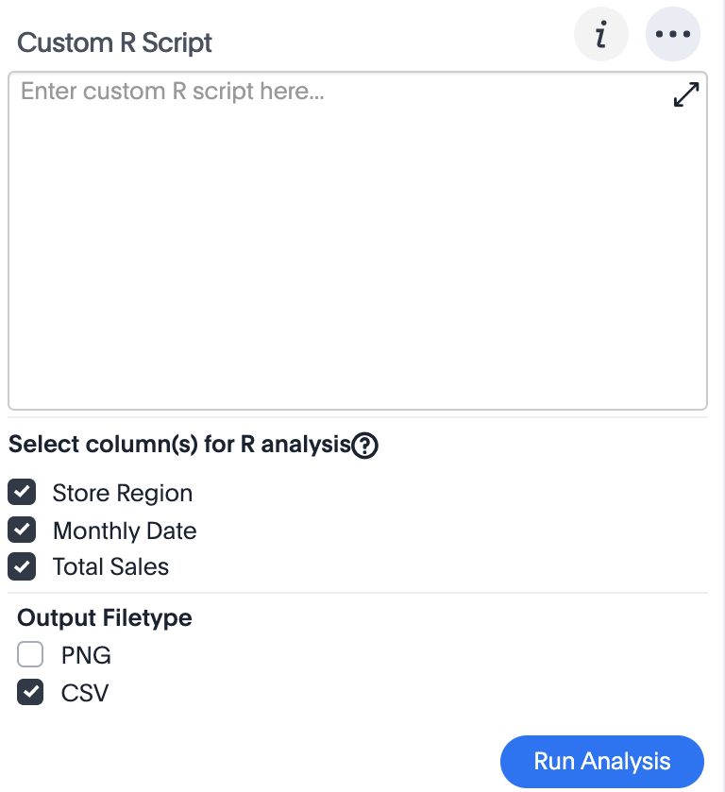

Custom R Analysis
Run your own custom R scripts, or run pre-built R scripts directly on search results.
R visualizations can be shared as Answers or Pinboards!
Notes:
R is a powerful programming language that makes it easy to perform advanced statistical analysis. You can run your own custom R scripts, or use scripts that are pre-loaded into ThoughtSpot. R visualizations can be shared as Answers or Pinboards.

Slide 44
Conditional Formatting

Slide 45



Conditional Formatting in a Chart
You can apply conditional formatting to tables or charts to highlight values in your data.
Notes:
You can add conditional format by clicking the x or y axis. This makes values above, below, or within a particular threshold stand out. For example, you can add visual keys to metrics to easily show where you are falling short or exceeding targets.

Slide 46

Conditional Formatting in a Chart
You can compare multiple metrics or KPIs.
Use this for important metrics you track daily, monthly, or quarterly.
Notes:
For charts, you can add conditional formatting to show the threshold(s) you defined, and the data that falls within them will be shown using the same color.

Slide 47


Conditional Formatting in a Table
Set a cell’s color based on the value it contains. Select Conditional Formatting from the ellipsis icon.

Slide 48
Complex Searches: Growth
Notes:
ThoughtSpot has many built in keywords to help users define their search. See the keywords reference of the documentation site for a full list of keywords. This slide deck will touch on some of the most popular keywords. https://docs.thoughtspot.com/5.3/reference/keywords.html
You can show growth over time with the “growth of” keyword.

Slide 49

Show Growth Over Time
Type “growth of” into the search bar and view selections
Notes:
When you type ”growth of” in the search bar, ThoughtSpot will suggest measures to choose from. You can also type a different column name containing numeric data to compare. The growth is calculated as a percentage for each period relative to the last period in the series.

Slide 50

Show Growth Over Time
Waterfall charts are especially effective at showing growth. Change your chart type to “waterfall chart” and take a look!
Notes:
You can also do year over year analysis, which compares each time period to the corresponding time period in the prior year; this is useful in retail and other seasonal businesses. To do this, type “monthly year-over-year” after the growth of phrase in the search bar.

Slide 51
Complex Searches: Time Keywords

Slide 52

Period Grouping
Comparisons like sales over time are more meaningful when you compare the same time frames.
To see this, type “sales quarterly”.

Slide 53

Period Grouping
Now add “yearly” to your search.
Switch to a bar chart.
Notice how much easier it is to see what’s happening over time?
Notes:
You can combine time keywords, such as “quarterly yearly” to compare the same quarter across years.

Slide 54
Complex Searches: Versus

Slide 55


Versus
The “versus” keyword allows for meaningful comparisons to be made, right from the search bar.
Examples:
Notes:
Use the versus keyword to compare measures.

Slide 56
Inline subquery

Slide 57
In keyword
Do a search on top of a search using an inline subquery! ThoughtSpot matches the values of the field before the IN clause with the values of the first attribute inside the parentheses.
Notes:
Beginning with version 5.2 of ThoughtSpot, you no longer need a View when you want to do a search on top of another search, commonly known as a subquery. You can use the IN keyword instead. The IN clause allows you to do a query on top of a main query.
In the example above, the search of “product sales 2019” will only include products that were in the top 10 sales in 2018.

Slide 58
Use Formulas

Slide 59



Add a Formula to an Answer
Use formulas to create derived columns in Worksheets. You can see a list of formula operators with examples in the Formula Assistant
Notes:
You can define formulas and use them to create derived columns in worksheets. Anyone who can create a worksheet can add a formula to it. Formulas are not reusable; the formula you create is associated only with the worksheet it belongs to. A complete list of available formulas and examples of each is available in the Formula Assistant. You can create a formula in a worksheet by using the Formula Builder. When you do this, the result of the formula gets added to the worksheet as a column.

Slide 60

Add a Formula to an Answer
Example: if ( sum ( sales ) > 2000 ) then 'record week' else 'normal week
Notes:
Formula elements are color coded by type, and can include the formula operators and functions (blue), the names of columns (purple), and/or constants (black). What you save your formula as will be the name of the new derived column on your worksheet. That Formula will only persist on the Data Source it is created on.

Slide 61
Advanced Formulas

Slide 62
Two Kinds of Formulas
Row-Wise Formulas
Act on and individual row and return one results per row
Examples: add, subtract, multiply, divide, contains, if..then..else
Aggregate Formulas
Combines rows together to return a single results.
Examples: Cumulative sum, moving average, standard deviation
Notes:
You can tell which formulas are aggregation formulas by looking at the function list in the Formula Assistant. Aggregation functions have their own section.

Slide 63

Aggregate Formulas: Period Moving Average
It can be hard to identify trends over time when data is variable. Use the Period Moving Average to smooth fluctuations and notice trends.
Notes:
Some more advanced aggregation functions are widely used in business intelligence, since they provide better insight into data. One example of this is the Period Moving Average.

Slide 64

Aggregate Formulas
Add a 3 period moving average and 6 period moving average to the same chart to see how variations in data is smoothed out and pattern emerges.
Notes:
Note that the 6 day moving average of your first row is only divided by five, since a day does not precede the first day. This formula smooths out fluctuations in the data, makes data easier to understand.
Examples:
3 period moving average formula: moving_average (sales, 1 , 1 , date)
6 period moving average formula: moving_average (sales, 4 , 1 , date)
Each of the moving formula accepts a measure, two integers to define the window, and one or more optional attributes.

Slide 65

Nested Formulas
You can also nest a formula within another formula!
Notes:
Nested formulas, or formula on formula, allow you to reference a formula within another formula. These formulas become columns, and are even suggested within the Formula Builder. There is no limit to the nesting depth you can create. You cannot delete a formula that is nested in another.

Slide 66
Group Aggregate Formulas
Group_Aggregate syntax:
group_aggregate (<aggregation(measure)>, <groupings>, <filters>)
Replace with:
query_groups() to use default report grouping
or
{} for no grouping
Replace with:
query_filters() to use default report filtering
or
{} for no filtering
Notes:
The group_aggregate function makes it possible to aggregate measures at levels that are different from the dimensions or column groupings used in the search. Typically ThoughtSpot calculates a measure at the lowest level of a particular dimension; if we want to see a measure calculated on different levels of the same dimension in the same search, we can use the group_aggregate formula. This function gives you more control over aggregation and filtering.
Examples:
group_aggregate (sum(sales), {region}, query_filters())
group_aggregate (sum(sales), {}, {})

Slide 67
Upload Data
Notes:
You can upload your own data table easily from the ThoughtSpot user interface! Please note that only users who belong to a group with the “Can administer ThoughtSpot” or “Can Upload User Data” permissions can upload their own data from the browser. The maximum file size that can be uploaded is approximately 50 MB.

Slide 68

Upload Data From User Interface
Upload CSV files into ThoughtSpot from your browser! Click Upload Data in the ellipsis icon of the Data tab.

Slide 69

Upload Data From User Interface
Drop your CSV file into the landing area
Notes:
Browse your machine, or load your table, into the landing area. Indicate whether your table has column names, and what the field separators are.

Slide 70


Upload Data From User Interface
Select Next to continue, and select Upload.
Notes:
ThoughtSpot can often guess the data types correctly, but you can change before completing the upload.

Slide 71

View Imported Data
When your table has been uploaded, you can immediately append an existing table, search or explore your data, or run SpotIQ analysis.
Notes:
View your imported data from the Data tab. You can filter by Yours to see all data you uploaded. You can click hyperlinked data values directly from a table.

